Slide 1

Freight Volume Prediction
Advanced time-series forecasting for smarter logistics planning and operational efficiency
Gopalakrishnan Kumar, MTech IIT-BombayFreelance Data Science Consultant

Slide 2


The Strategic Imperative
Freight volume forecasting is a mission-critical capability for logistics providers, ports, railways, and supply chain planners. Accurate predictions enable organizations to optimize container capacity, adjust fleet requirements, and plan shipping schedules with precision.
Capacity Optimization
Resource Planning
Right-size container and cargo allocations based on predicted demand
Adjust fleet, manpower, and infrastructure for peak periods
Bottleneck Prevention
Identify and eliminate operational constraints before they impact service
This project applies the powerful SARIMAX forecasting algorithm to model monthly freight volumes, capturing both trend and seasonal patterns inherent in logistics operations.

Slide 3
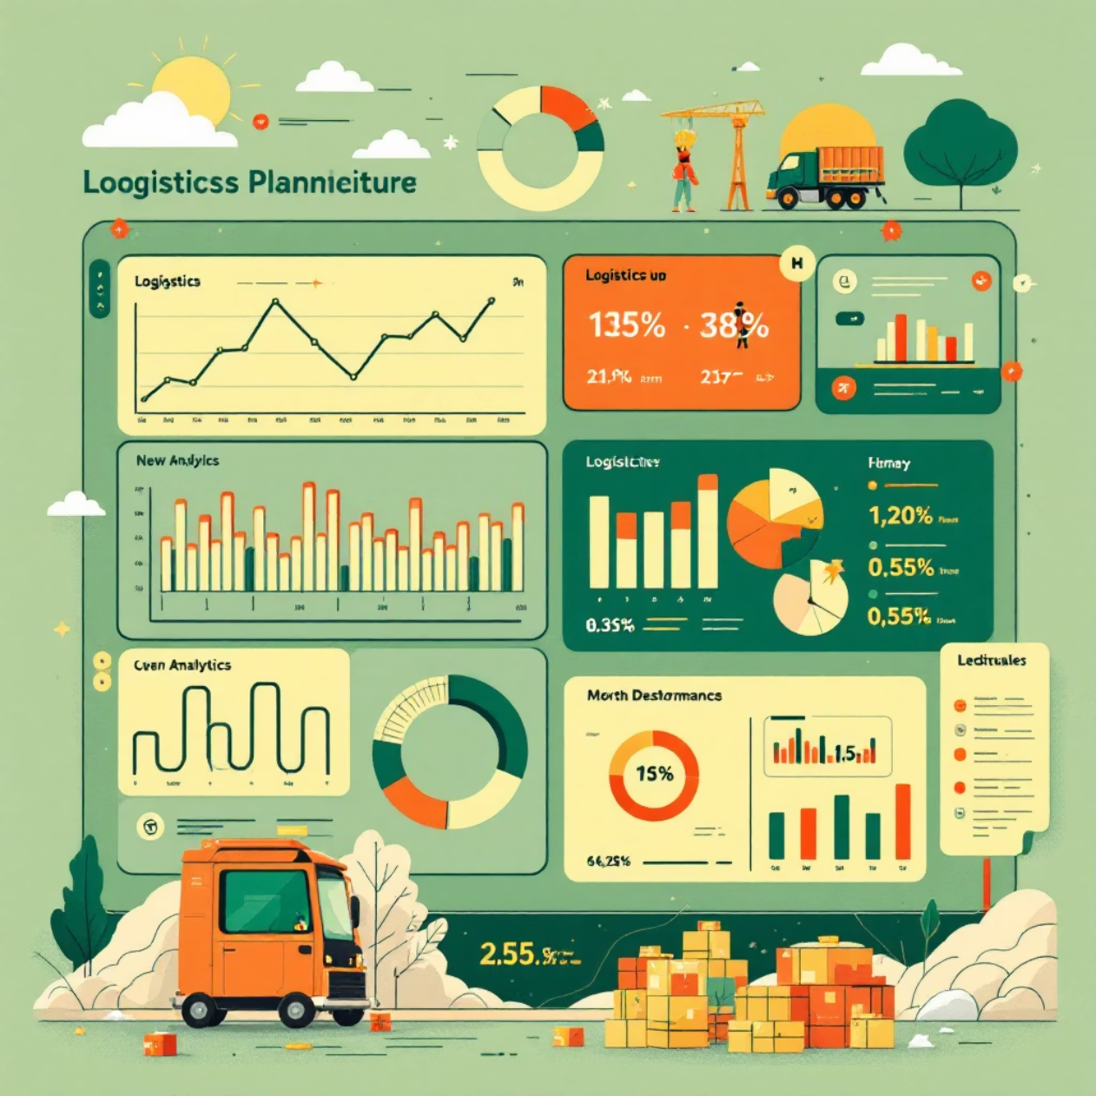
Business Objectives & Expected Outcomes
Core Objective
Forecast freight volumes for the next 24–36 months with high confidence, enabling long-term strategic planning and tactical execution across the supply chain.
Key Focus Areas
Identify trend patterns and seasonal cycles
Provide actionable insights for logistics planning
Support data-driven decision-making
Operational Excellence
Cost Reduction
Supply Chain Intelligence
Improved efficiency through better resource allocation and scheduling
Reduced demurrage, detention costs, and empty container repositioning
Enhanced inventory management and supplier coordination

Slide 4
Dataset Architecture
A comprehensive synthetic monthly freight dataset spanning January 2015 to December 2024 was engineered to replicate real-world cargo movement patterns across multiple transportation modes.
Column
Description
Date
Monthly timestamp for time-series analysis
Freight_Volume
Total monthly freight demand (tonnage, TEUs, or units)
Sea_Freight
Estimated cargo volume moved by maritime routes
Rail_Freight
Estimated cargo volume transported by rail networks
Road_Freight
Estimated cargo volume delivered via road transport

Slide 5

Data Characteristics
Clear Upward Trend
Strong Seasonality
Realistic Noise
Consistent growth trajectory reflecting expanding trade volumes and economic development over the analysis period
Repeated annual cycles driven by festival import seasons, harvest periods, and holiday shipping demands
Operational fluctuations that mirror real-world variability in freight operations and market conditions
Why SARIMAX? The data exhibits non-stationary behavior combining trend and seasonality, making SARIMAX the ideal forecasting approach for capturing complex temporal patterns.

Slide 6
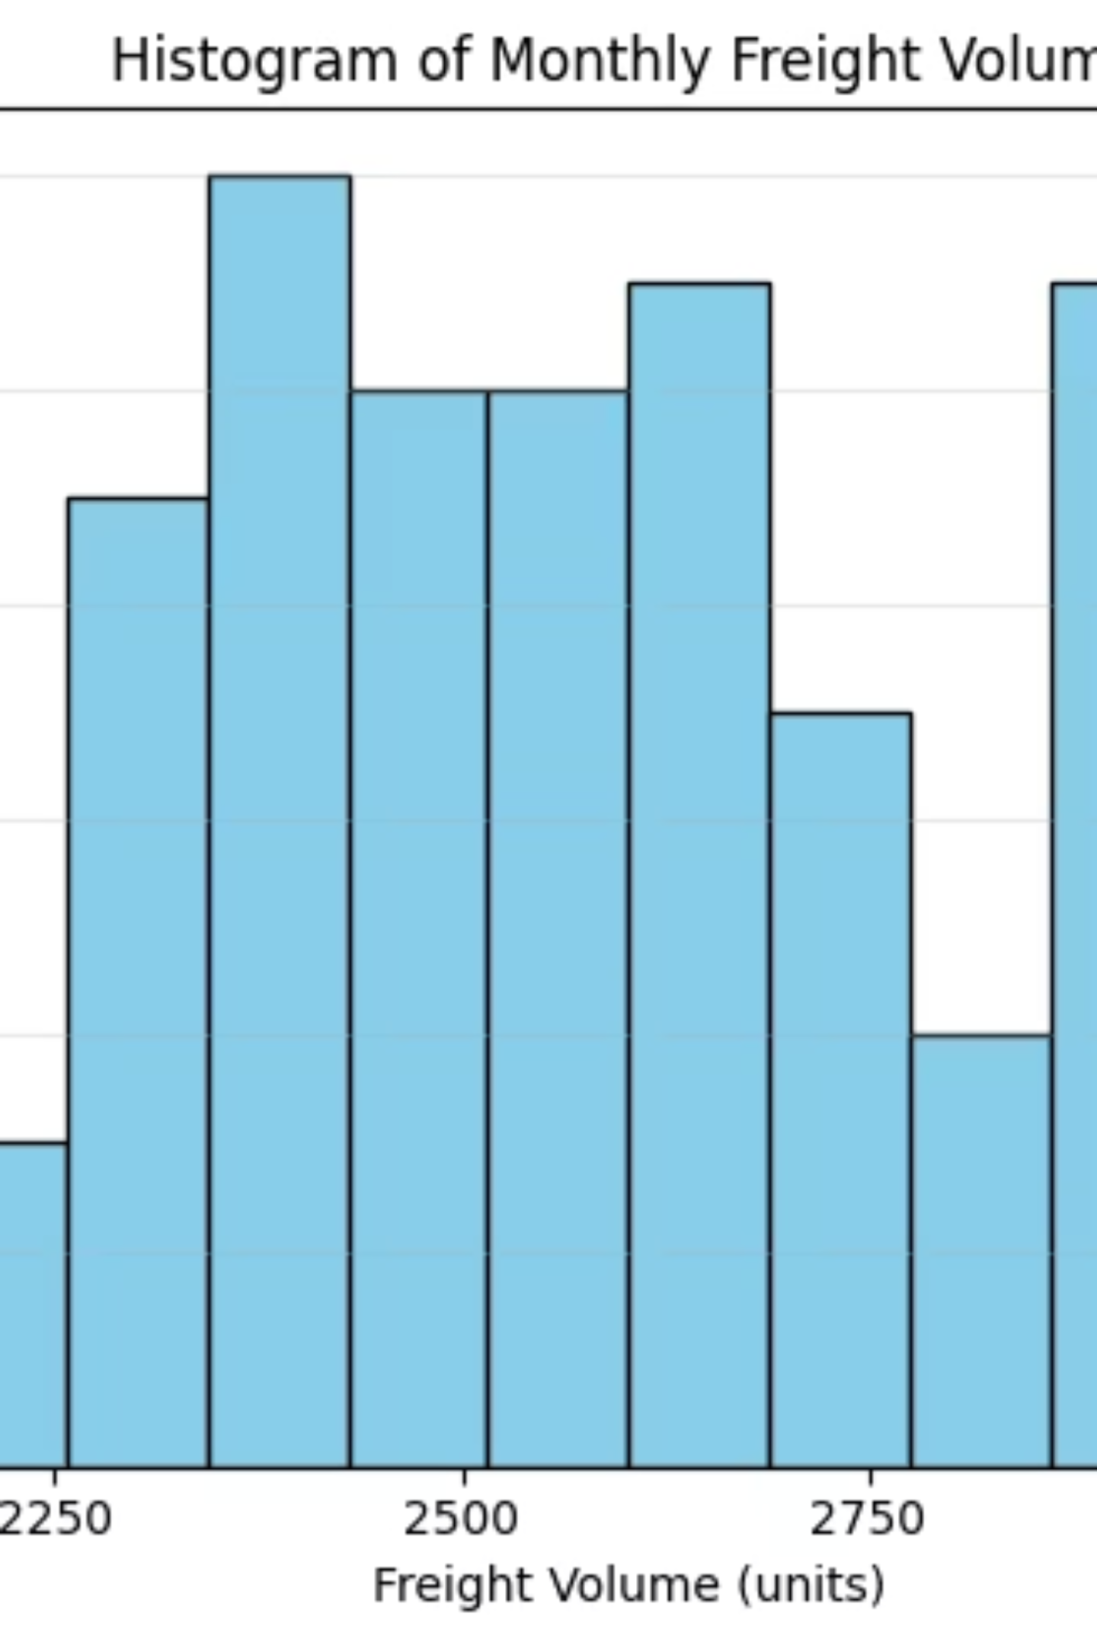
Freight Volume Trends Over Time
Key Observations
The time-series visualization reveals consistent year-over-year growth with pronounced seasonal variations. This pattern reflects increasing global trade volumes and recurring demand cycles tied to economic activity and seasonal commerce.
Sustained upward growth from 2015 to 2024
Regular seasonal peaks and troughs
Accelerating growth in recent years

Slide 7
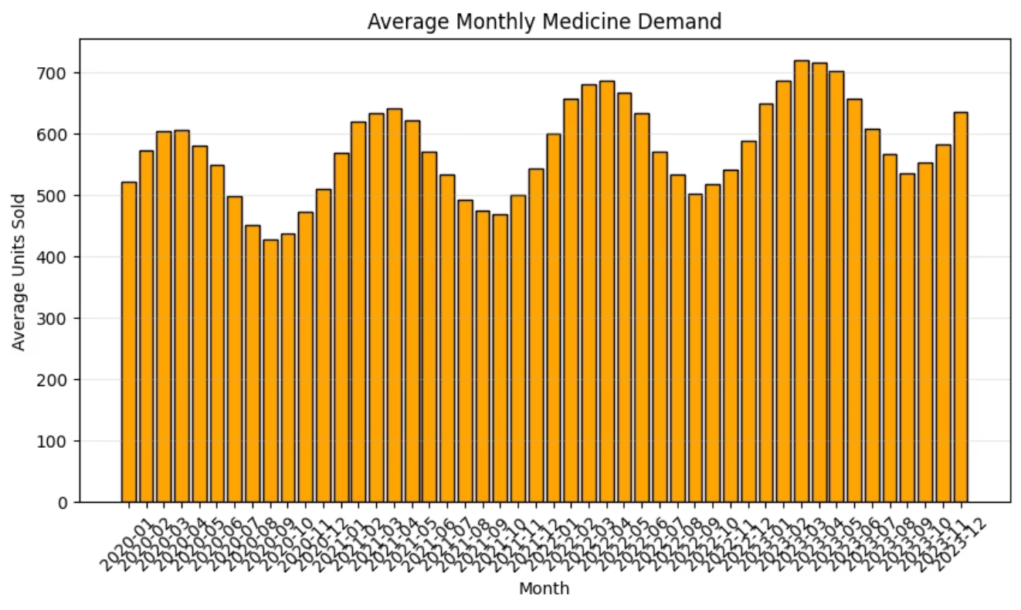
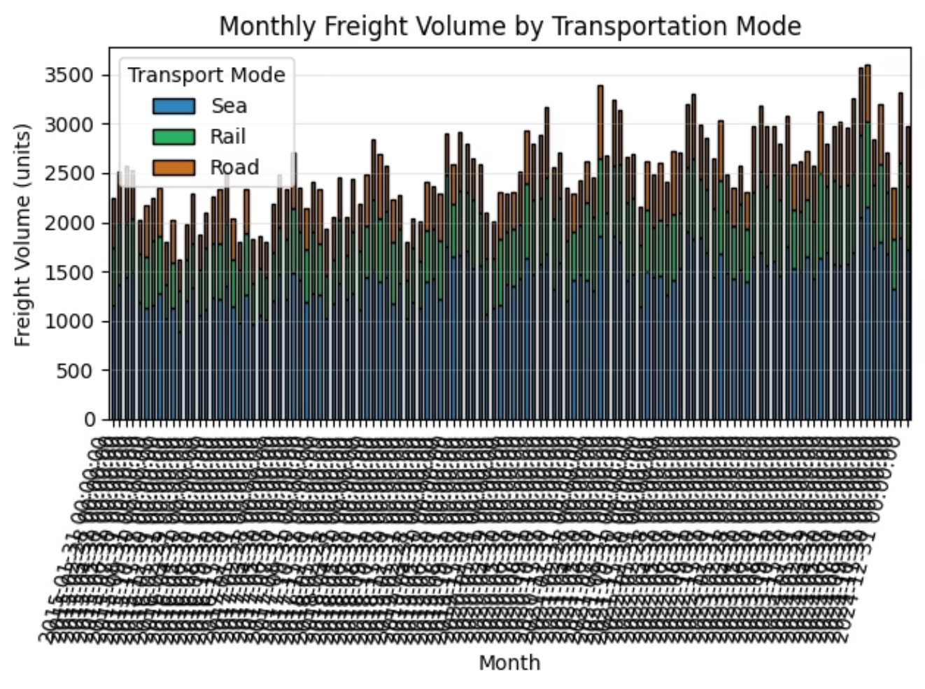
Distribution & Seasonal Patterns
Volume Distribution Analysis
Monthly Demand Cycles
The histogram shows concentration around moderate values with a long upper tail, reflecting growing demand and seasonal fluctuations.
Peak months: July–August and November–December (holiday, festival, harvest export seasons)
Low months: February–March (post-holiday slowdown)

Slide 8
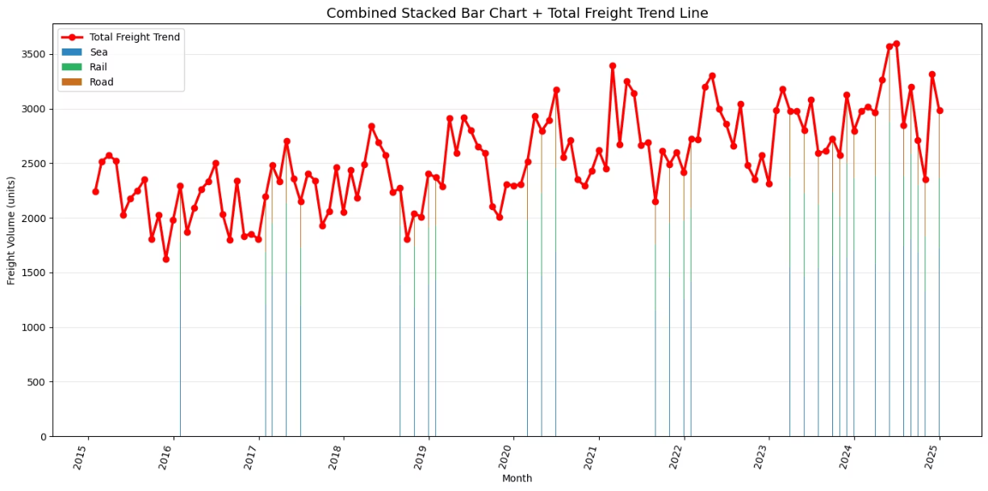
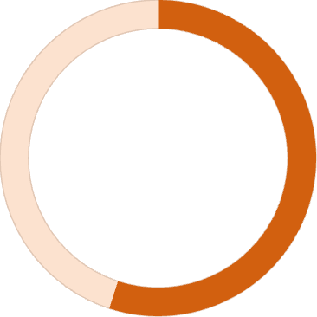
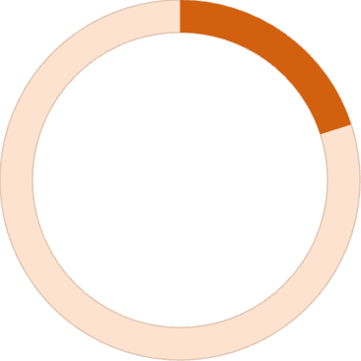
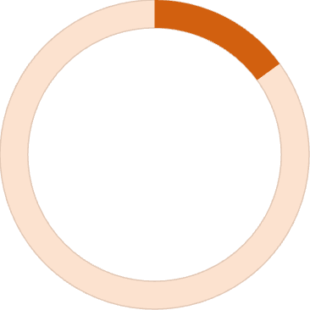
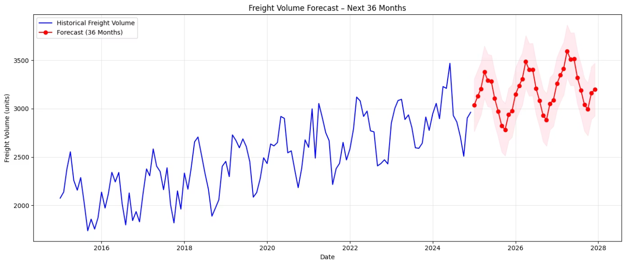
Multi-Modal Freight Analysis
55-65%
20-30%
15-25%
Sea Freight
Rail Freight
Road Freight
Dominates cargo movement as the backbone of international trade
Provides efficient inland connectivity and intermodal solutions
Delivers last-mile flexibility with seasonal variation
The combined stacked bar chart reveals total freight volume, mode-wise contributions, and clear year-over-year growth across all transportation modes.

Slide 9




SARIMAX Modeling Approach
Model Configuration
Component
Configuration
Non-seasonal order (p,d,q)
(1, 1, 1)
Seasonal order (P,D,Q,s)
(1, 1, 1, 12)
This configuration balances model complexity with predictive accuracy, capturing both short-term fluctuations and long-term seasonal patterns.
Why SARIMAX?
SARIMAX (Seasonal AutoRegressive Integrated Moving Average with eXogenous factors) is ideally suited for freight forecasting because it captures:
Long-term growth trends
Clear seasonal patterns (12-month cycles)
Confidence interval predictions
Historical Data
SARIMAX Model
Future Predictions
10 years of freight volumes
Trained on patterns
24-36 month forecast

Slide 10

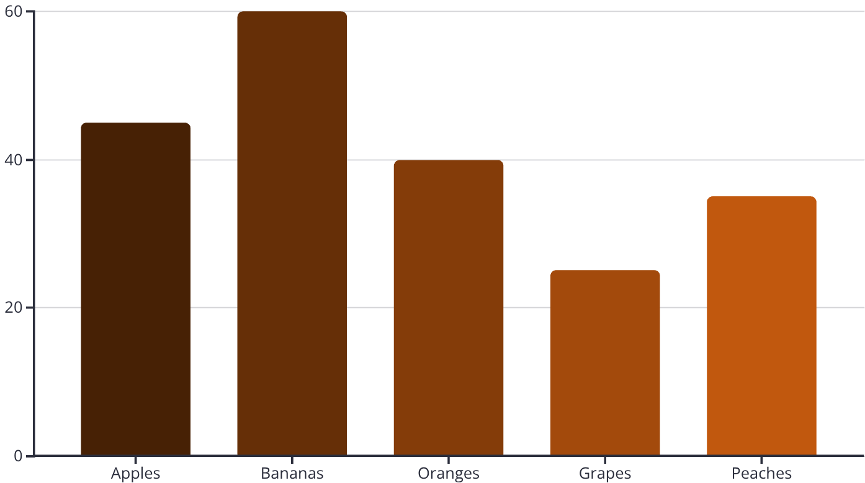
Business Impact & Strategic Value
This SARIMAX forecasting model delivers high-accuracy predictions with clear visibility into trend and seasonality, providing a reliable roadmap for capacity, fleet, and infrastructure planning.
Shipping Companies
Optimize container allocations
Plan sailing schedules efficiently
Balance vessel capacity
Road/Rail Transporters
Manage fleet utilization
Reduce empty trips and idling
Optimize route planning
Port Authorities
Regulate docking windows
Reduce congestion
Minimize demurrage charges
SCM Teams
Predict cargo flows
Improve supplier coordination
Enhance inventory management
Connect with the author: LinkedIn: Profile | GitHub: Repository | Kaggle: gopalkk2 | View Project in Google Colab

